Slide 1

Depth First Search(DFS)
MUHAMMAD NAJIB BIN MOKHTAR 1510955
MUHAMMAD AZRI BIN MAHANIF 1512761
MUHAMAD SYAHMI BIN CHE YUSOFF 1513091
MUHAMMAD ZHAFIR BIN IBRAHIM 1511393

Slide 2
Objective
To practice on tree traversals, graph traversal dealing with real world problem.
To implement possible heuristics to reduce the complexity while traversing.
To solve general Knight’s tour problem.

Slide 3
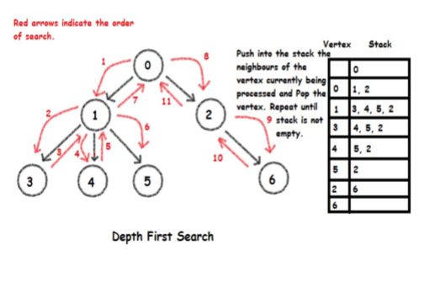
Depth First Search
The DFS algorithm is a recursive algorithm that use the idea of backtracking.

Slide 4
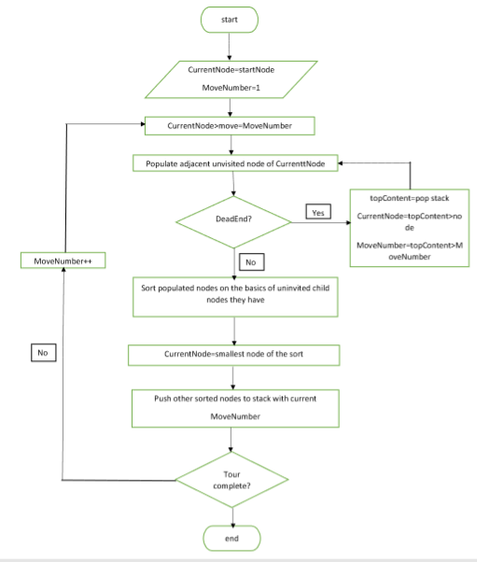
Flowchart

Slide 5
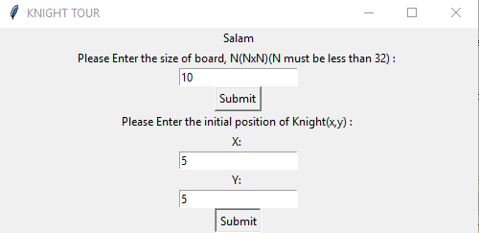
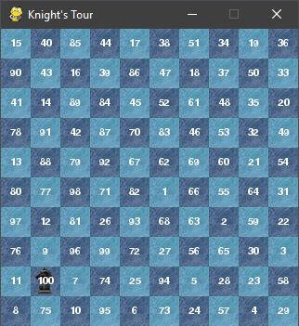
Program

